Slide 1
Indeed.com
To evaluate the development of data analysis in HK & SG through Indeed.com
Group 3
Lota | Ellery | Maggie

Slide 2
Objectives
- Collecting data from local job websites
- Clean the data
- Feature Engineering
- Explore the data and find insights
- Visualize it and find what you found
- Challenge
Two Main Theme:
Data Analyst
Data Scientist
Comparison
Hong Kong Indeed.com
Singapore Indeed.com
Notes:
Dataframe (hk n singapore)
Data cleaning
Feature engineering
Programming tools, Visualisation tools
Challenge

Slide 3
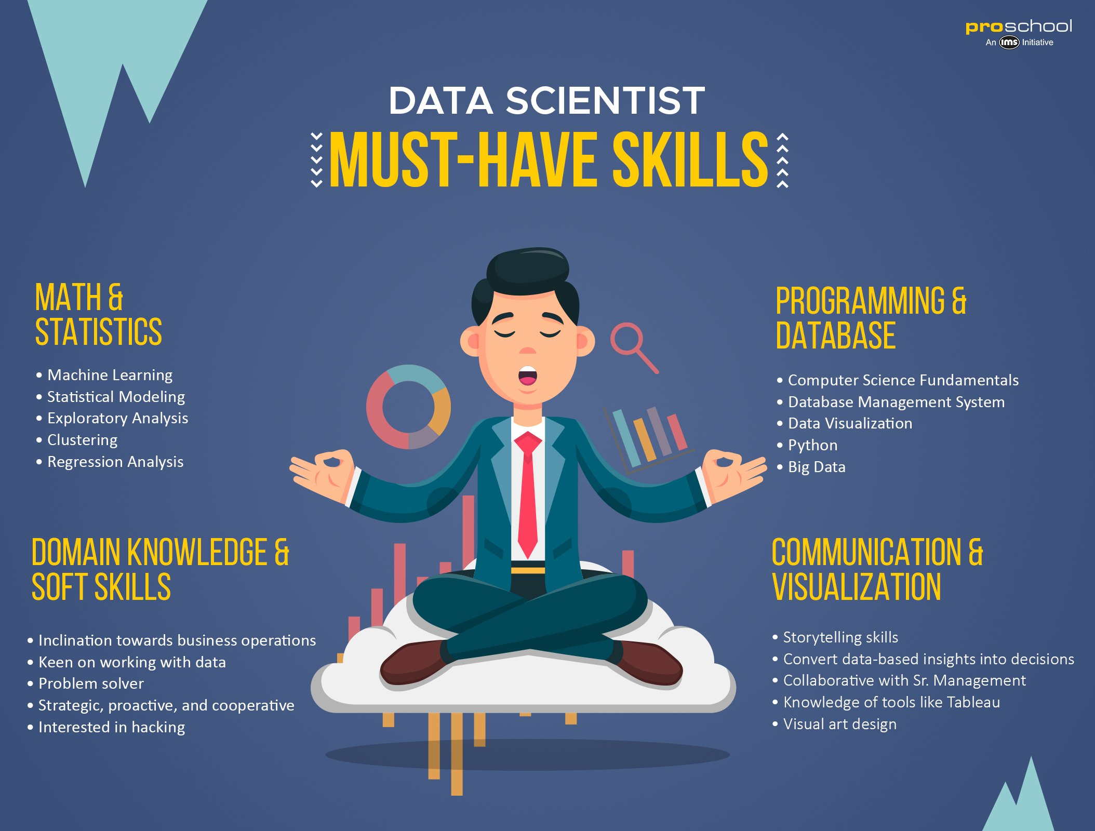
Assumption:
Education Level
Our target candidate should be majoring in one of the following academic disciplines:
IT
Computer Science
Computer Engineering
Mathematics
Statistics
Business Analysis
Any related academic disciplines
Notes:
Industry
Retail
Banking
Finance
Insurance
logistics

Slide 4
Problem Statement
As a HR consultant, we want to find out the job market trend for Data Analytics’ and Data Scientists’ role in Hong Kong and Singapore.
Points to be considered:
Talent’s skills set
Job requirement

Slide 5
Purpose of Project with Business Value
Provide insights for job seekers on:
Career advancement
Preparation for next job
Career Change
Provide insights for company on:
Average market price for data science job for reference
Demand of talents in industry

Slide 6

Methodology
BeautifulSoup:
Collect Data From Indeed.com
Regex:
Cleaning Unrelated Data
Extract important information
Pandas:
Data Visualization
Feature Engineering
Matplotlib / Seaborn:
Plotting a bar chart
Comparison with Singapore

Slide 7
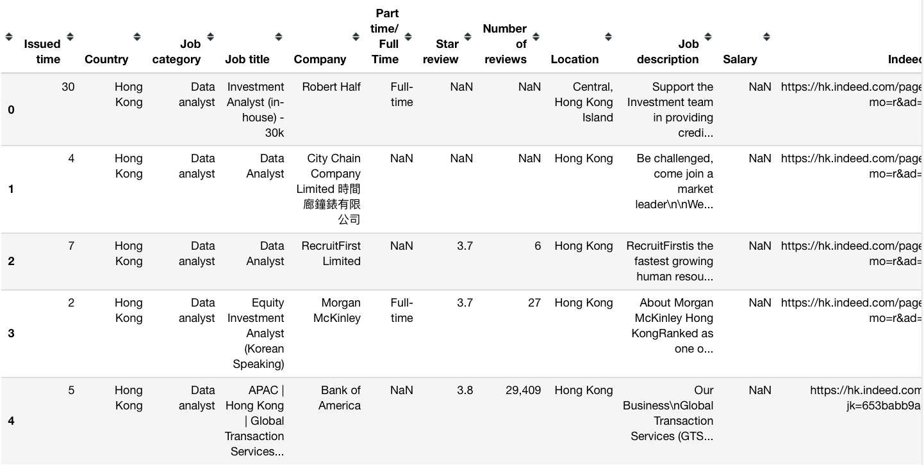
Data Collected
Original Information scrapped from Indeed.com:
Job Title
Company Name
Salary
Full-Time/Part-Time Mode
Location
Job Description
Issue Time
Same process for:
Job of Data Scientist in Hong Kong
Job of Data Analyst in Singapore
Job of Data Scientist in Singapore
Example of Data Analyst in Hong Kong

Slide 8
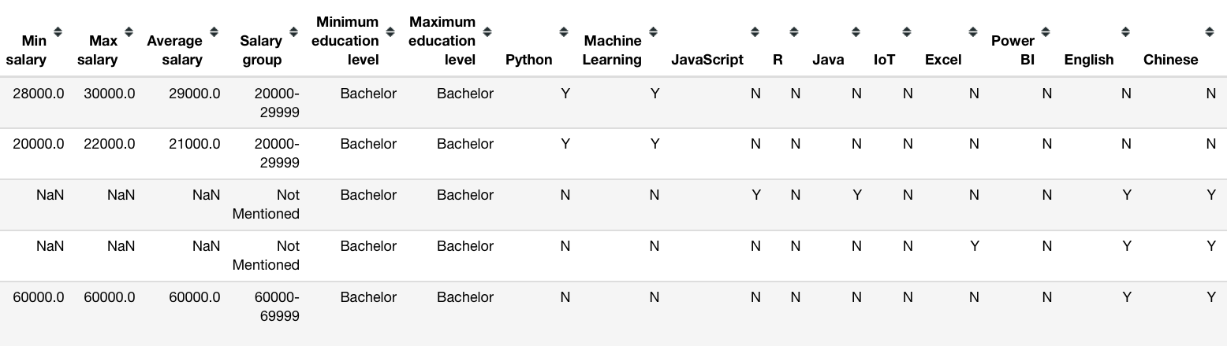
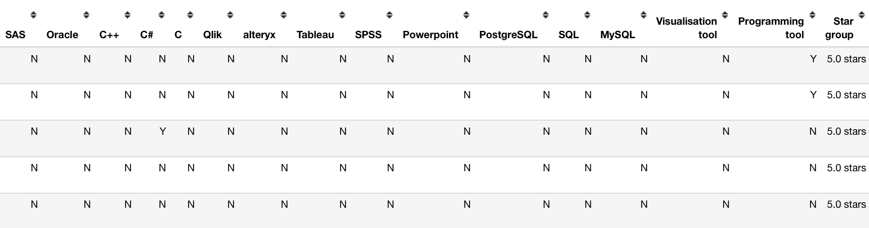
Data After Cleaning
Data Cleaning
Remove unnecessary information before feature engineering
Remove unrelated job based on specific criterias
Drop duplication of Job Posts
Feature Engineering
Look for Language Requirement
English, Chinese
Programming Tool: Python & R
Visualization Tool: Tableau, TensorFlow & Qlik
Look for Minimum & Maximum Degree Requirement
Categorize average salary into several Salary Range Group

Slide 9
Next Part:
Insight with Visualizations

Slide 10
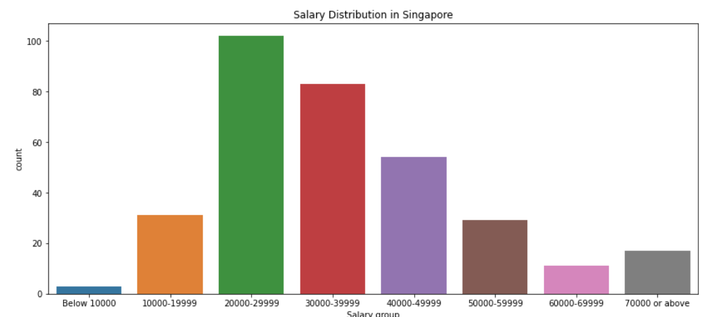
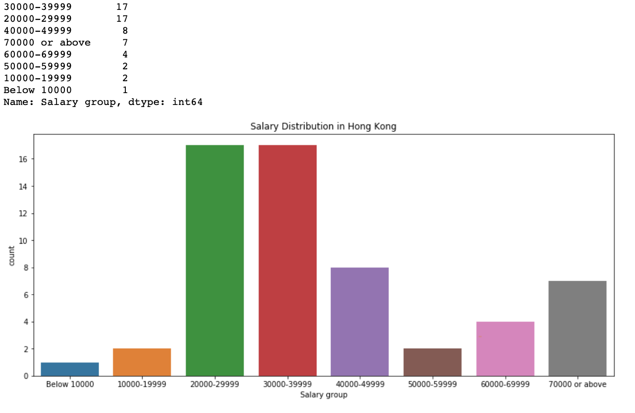
Salary
Singapore
Exclude all data without salary
On average
HK : $ 20-40k (based on 7 % data)
Singapore: $ 20-40k
Why for reference only?
Hard to identify job grade
Huge variance can be found
Result in inaccurate average salary
Hong Kong

Slide 11
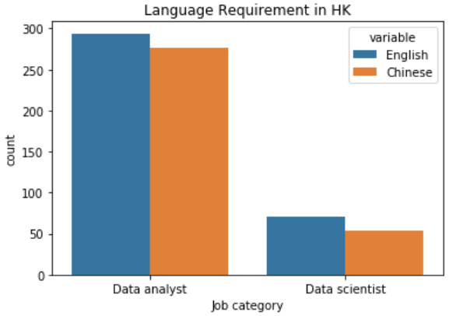
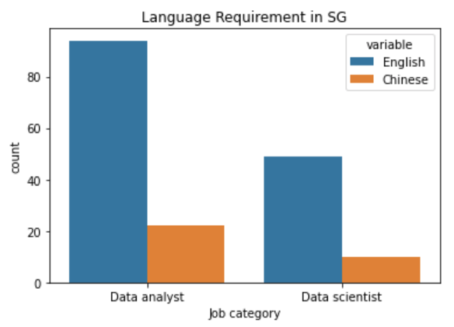
Language Requirement
In Hong Kong:
Needs to be fluent in both languages
Competitive advantage:
Cantonese/Mandarin
In Singapore:
Requirements of Chinese and English are taken for granted
Thus didn’t specify
Hong Kong
Singapore

Slide 12
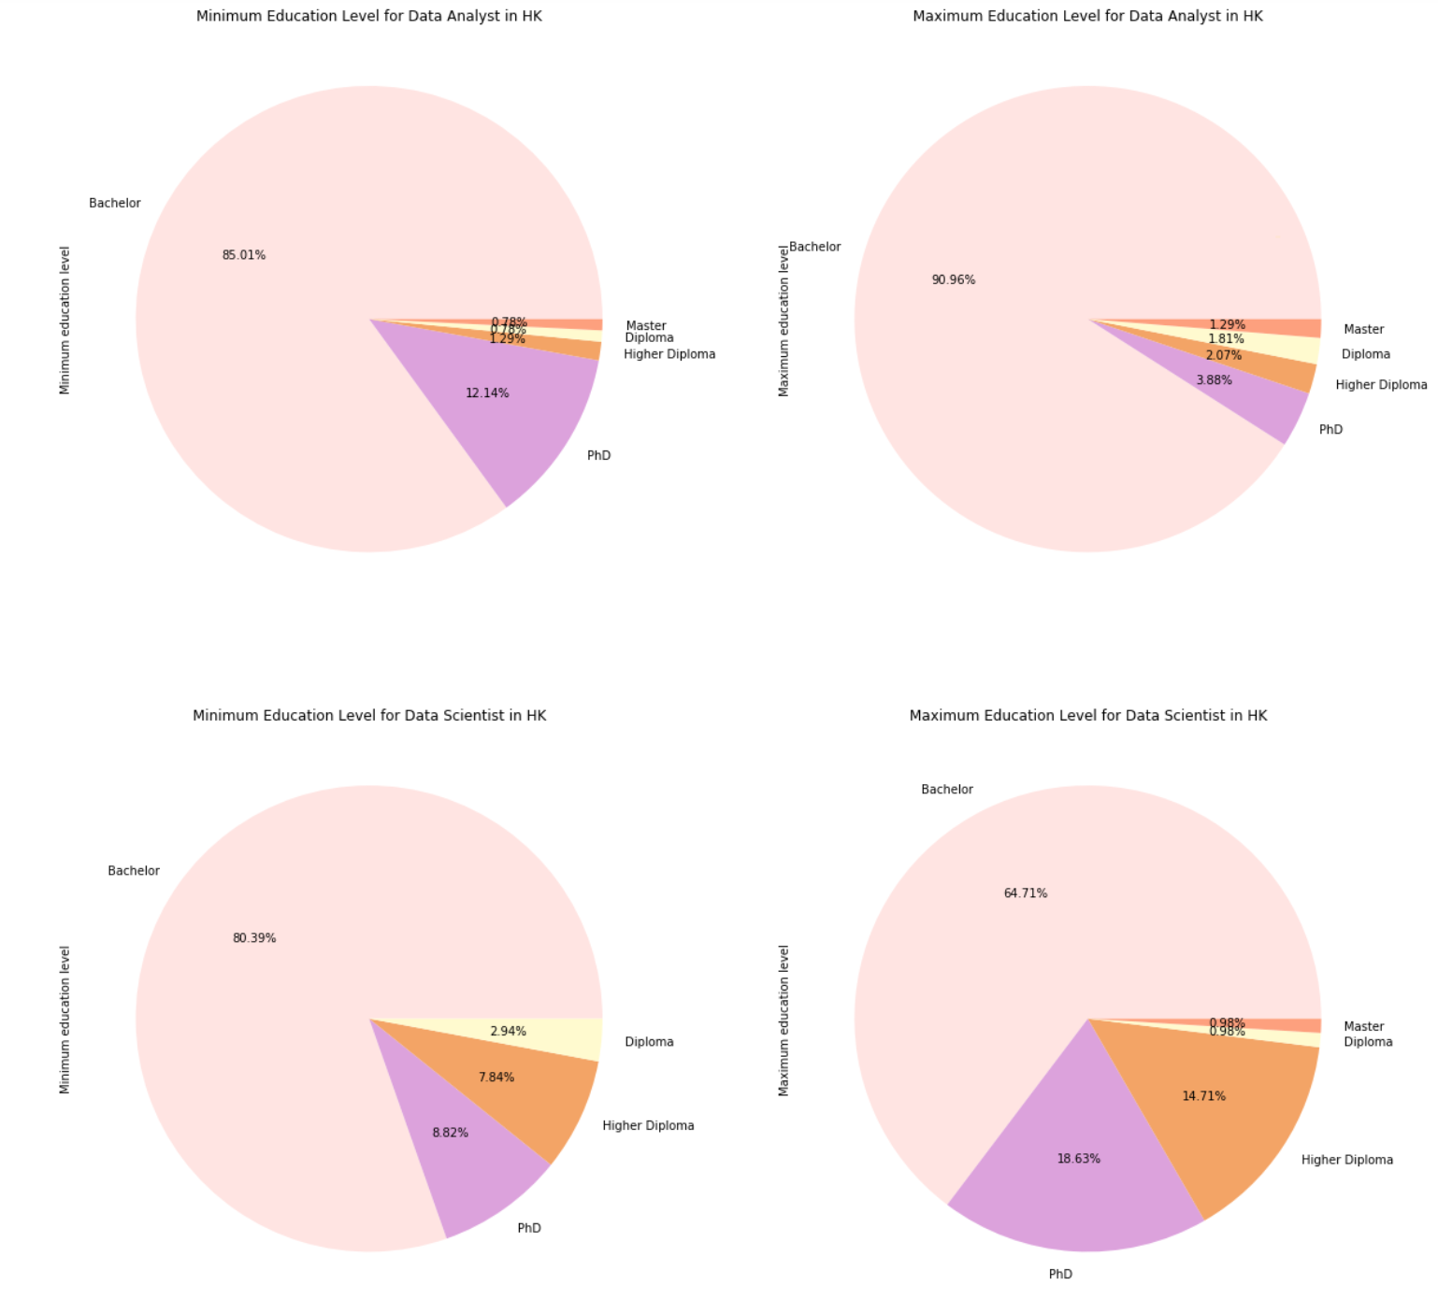
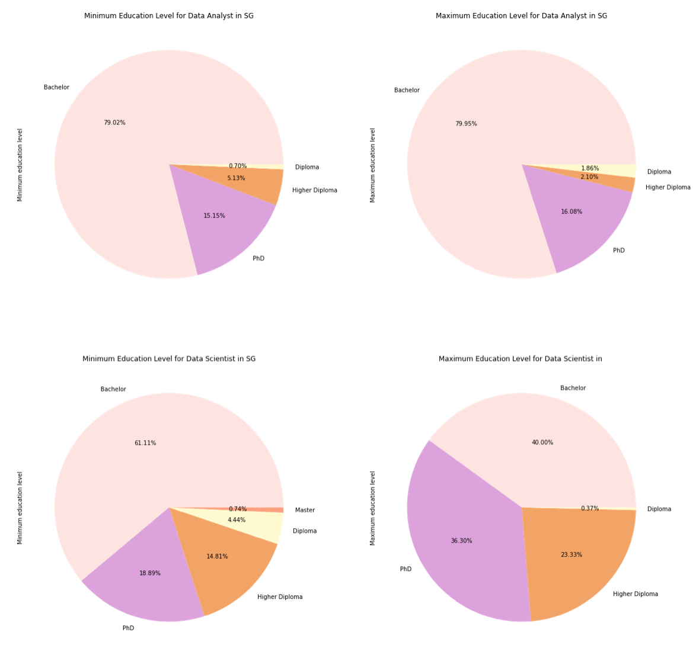
Education
Requirement
Data Analyst
Data Analyst
Data Scientist
Data Scientist
Singapore
Hong Kong
Notes:
fig = plt.figure(figsize=(20,20))
ax = fig.add_subplot(221)
ax2 = fig.add_subplot(222)
ax3 = fig.add_subplot(223)
ax4 = fig.add_subplot(224)
colors = ['mistyrose','plum','sandybrown','lemonchiffon','lightsalmon']
label = ['Bachelor','PhD','Higher Diploma','Diploma','Master']
df[(df['Job category'] == 'Data analyst') & (df['Minimum education level'] != 'Not specified')]['Minimum education level'].value_counts().plot(kind='pie',autopct='%.2f%%',title='Minimum Education Level for Data Analyst in HK', ax=ax, colors=colors, labels=label)
df[(df['Job category'] == 'Data analyst') & (df['Maximum education level'] != 'Not specified')]['Maximum education level'].value_counts().plot(kind='pie',autopct='%.2f%%',title='Maximum Education Level for Data Analyst in HK', ax=ax2,colors=colors, labels=label)
df[(df['Job category'] == 'Data scientist') & (df['Minimum education level'] != 'Not specified')]['Minimum education level'].value_counts().plot(kind='pie',autopct='%.2f%%',title='Minimum Education Level for Data Scientist in HK', ax=ax3,colors=colors,labels=label)
df[(df['Job category'] == 'Data scientist') & (df['Maximum education level'] != 'Not specified')]['Maximum education level'].value_counts().plot(kind='pie',autopct='%.2f%%',title='Maximum Education Level for Data Scientist in HK', ax=ax4,colors=colors,labels=label)

Slide 13
Education
Requirement
 |  | Hong Kong | Singapore
Data Analyst | Basic requirement | Bachelor’s Degree | Bachelor’s Degree
 | Competitive advantage | No obvious insight spotted | PhD
Data Scientist | Basic requirement | Bachelor’s Degree | Higher Diploma or Bachelor’s Degree
 | Competitive advantage | PhD or Master’s Degree | Mainly PhD

Slide 14
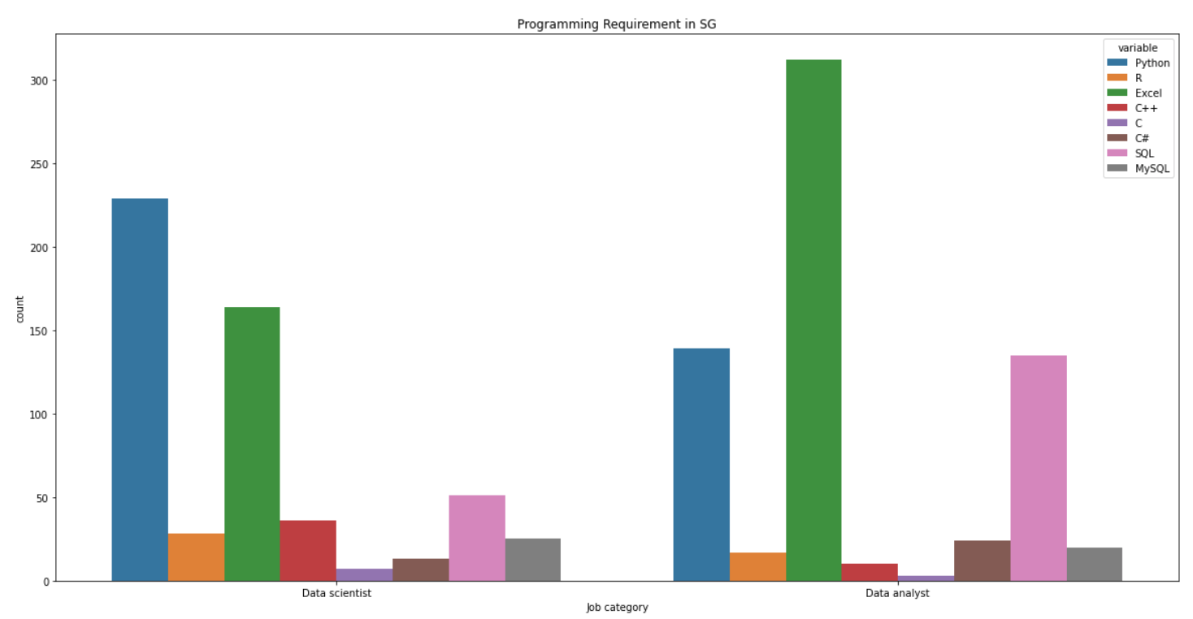
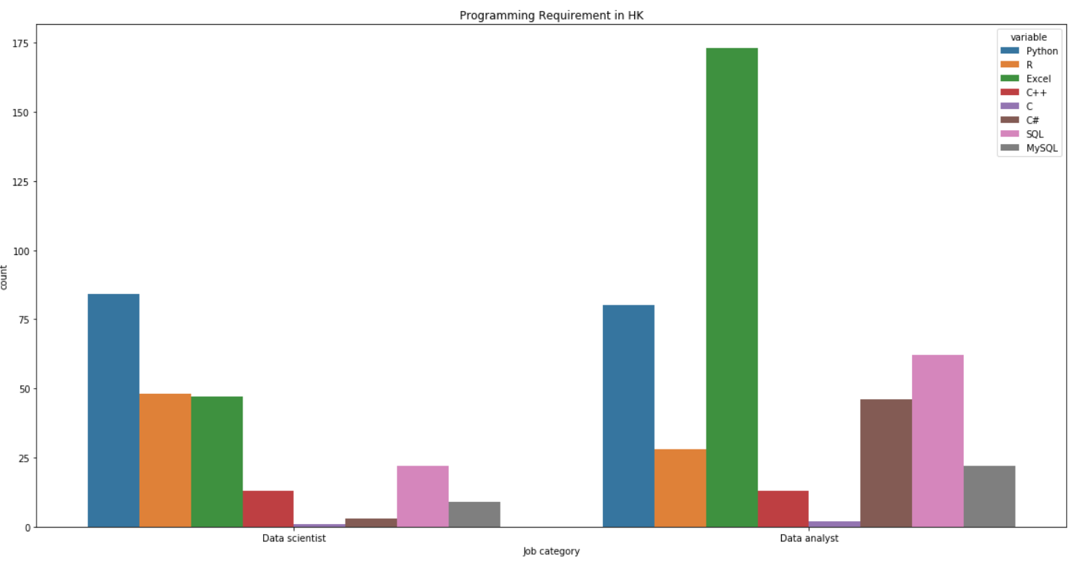
Programming Tool:
Python,R,Excel,C++,C,C#,SQL, MySQL
Singapore
Hong Kong
Data
Scientist
Data Analyst
Data Analyst
Data
Scientist
Notes:
fig = plt.figure(figsize=(20,20))
ax = fig.add_subplot(221)
ax2 = fig.add_subplot(222)
ax3 = fig.add_subplot(223)
ax4 = fig.add_subplot(224)
label = ['Y','N']
color = ['darkorange','moccasin']
df[df['Job category'] == 'Data analyst']['Visualisation tool'].value_counts().plot(kind='pie',autopct='%.2f%%',title='Visualisation skills of Hk Data Analyst', ax=ax, labels=label,colors=color)
df[df['Job category'] == 'Data analyst']['Programming tool'].value_counts().plot(kind='pie',autopct='%.2f%%',title='Programming skills of Hk Data Analyst', ax=ax2,labels=label,colors=color)
df[df['Job category'] == 'Data scientist']['Visualisation tool'].value_counts().plot(kind='pie',autopct='%.2f%%',title='Visualisation skills of Hk Data Scientist', ax=ax3,labels=label,colors=color)
df[df['Job category'] == 'Data scientist']['Programming tool'].value_counts().plot(kind='pie',autopct='%.2f%%',title='Programming skills of Hk Data Scientist', ax=ax4,labels=label,colors=color)

Slide 15
Programming Tool:
Python,R,Excel,C++,C,C#,SQL, MySQL
 | Hong Kong |  | Singapore
 | Data Analyst | Data Scientist | Data Analyst | Data Scientist
1st | Excel | Python | Excel | Python
2nd | Python | R | Python | Excel
3rd | SQL | Excel | SQL | SQL
4th | R | SQL | C# | C++
Excel is still a necessary skill nowadays > going to be replaced by Python soon
More statistical models need to be run by data scientist in HK
Fun fact: R is not that common in Singapore

Slide 16
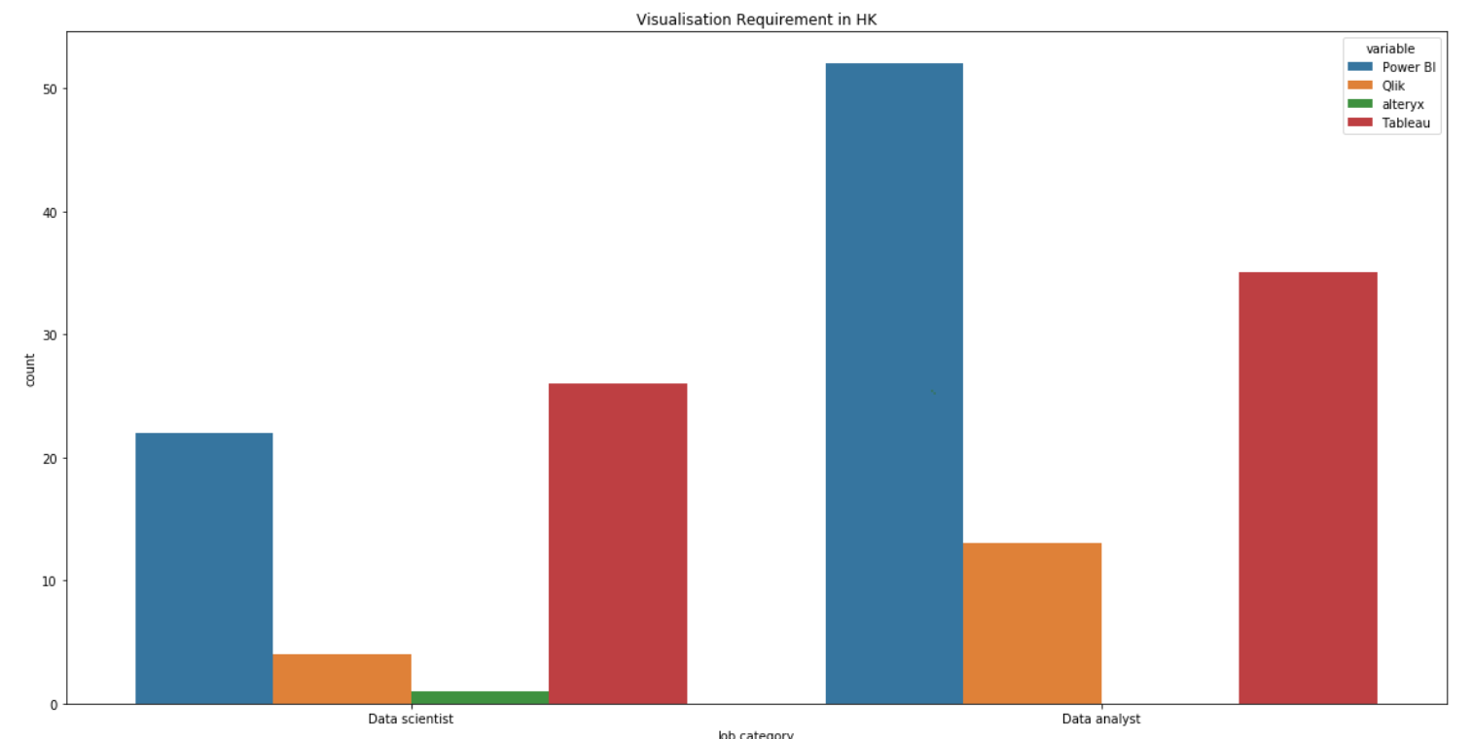
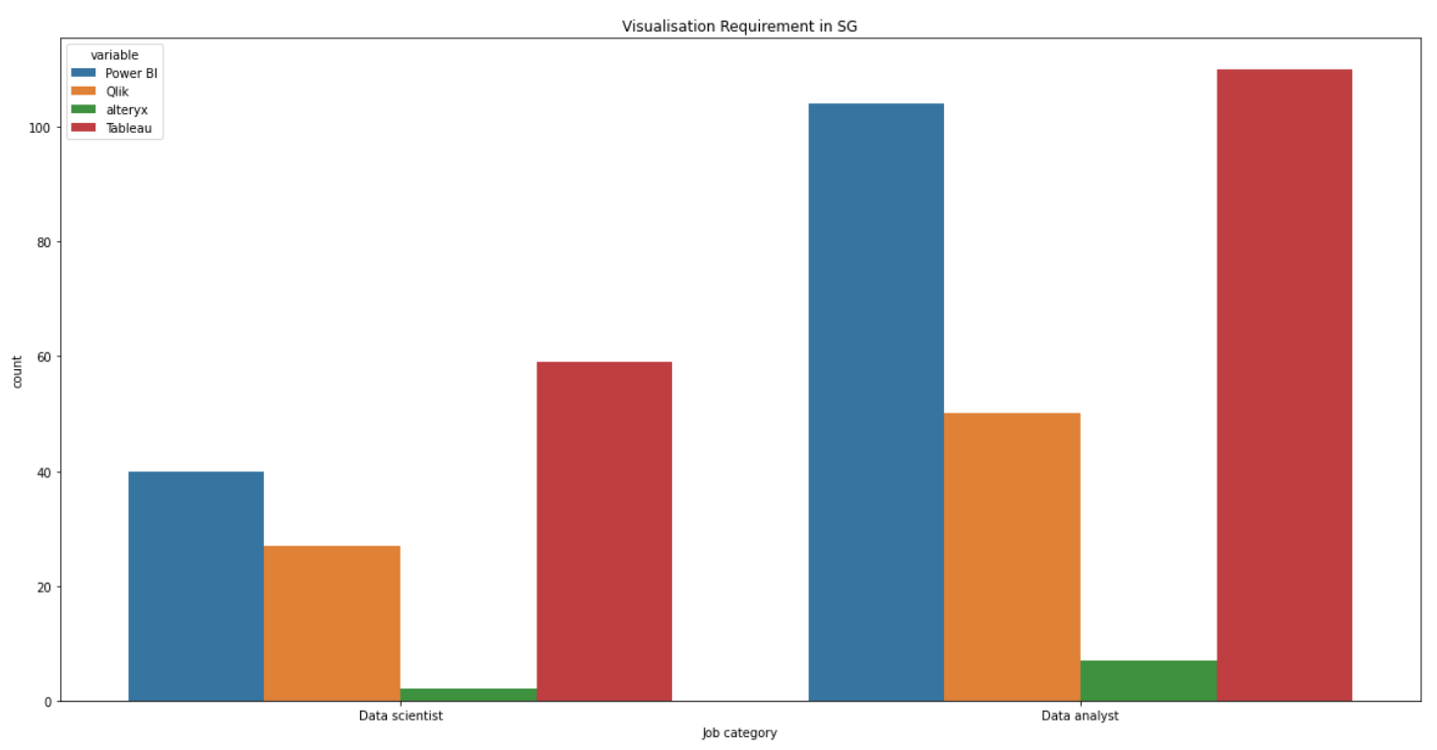
Visualization Tool:
Tableau, Power BI &
Qlik bar chart
Singapore
Hong Kong
Data
Scientist
Data Analyst
Data Analyst
Data
Scientist
Popular skills (HK & SG): Power BI & Tableau
Notes:
fig = plt.figure(figsize=(20,20))
ax = fig.add_subplot(221)
ax2 = fig.add_subplot(222)
ax3 = fig.add_subplot(223)
ax4 = fig.add_subplot(224)
label = ['Y','N']
color = ['darkorange','moccasin']
df[df['Job category'] == 'Data analyst']['Visualisation tool'].value_counts().plot(kind='pie',autopct='%.2f%%',title='Visualisation skills of Hk Data Analyst', ax=ax, labels=label,colors=color)
df[df['Job category'] == 'Data analyst']['Programming tool'].value_counts().plot(kind='pie',autopct='%.2f%%',title='Programming skills of Hk Data Analyst', ax=ax2,labels=label,colors=color)
df[df['Job category'] == 'Data scientist']['Visualisation tool'].value_counts().plot(kind='pie',autopct='%.2f%%',title='Visualisation skills of Hk Data Scientist', ax=ax3,labels=label,colors=color)
df[df['Job category'] == 'Data scientist']['Programming tool'].value_counts().plot(kind='pie',autopct='%.2f%%',title='Programming skills of Hk Data Scientist', ax=ax4,labels=label,colors=color)

Slide 17
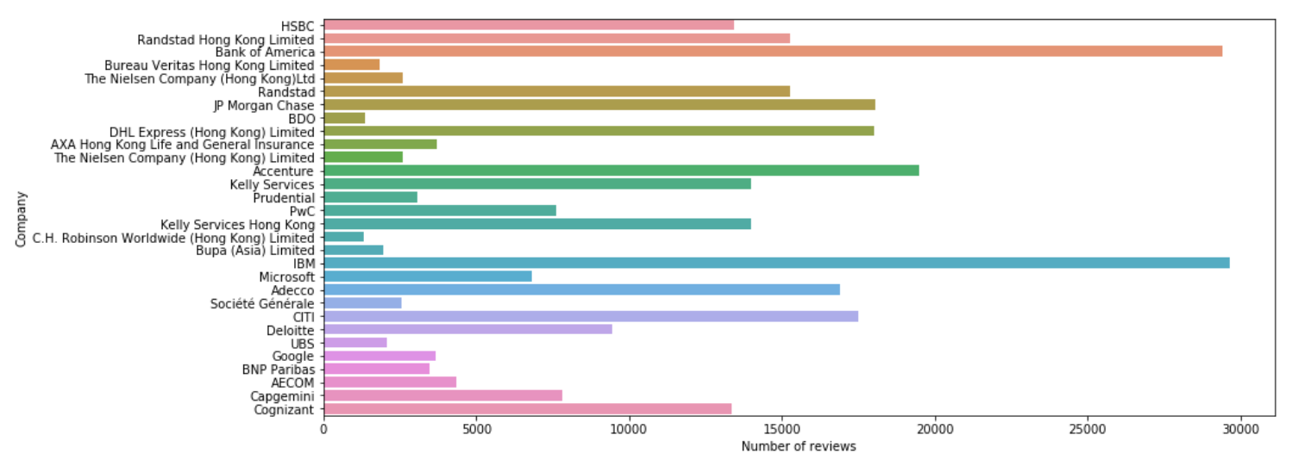
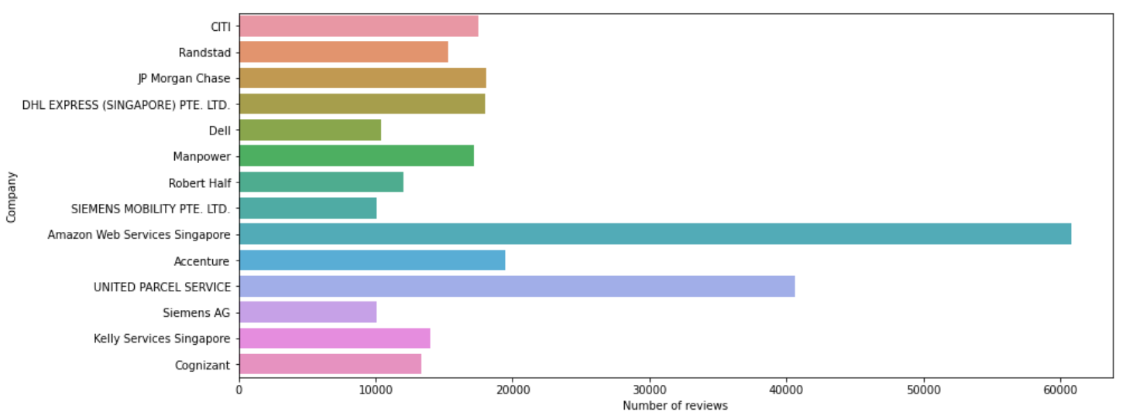
Number of Reviews (HK)
(Only show Companies with 1000+ reviews)
HK
All are MNCs
More MNC job offers in HK
SG

Slide 18
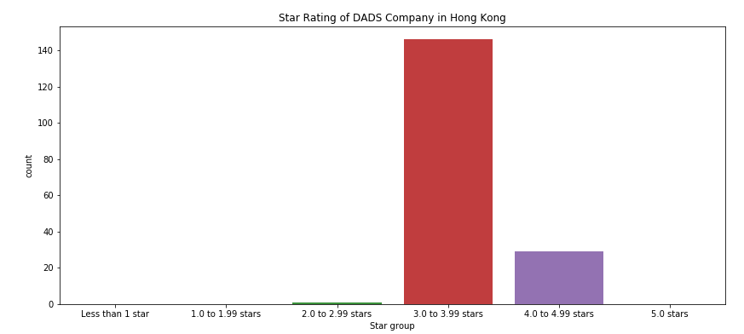
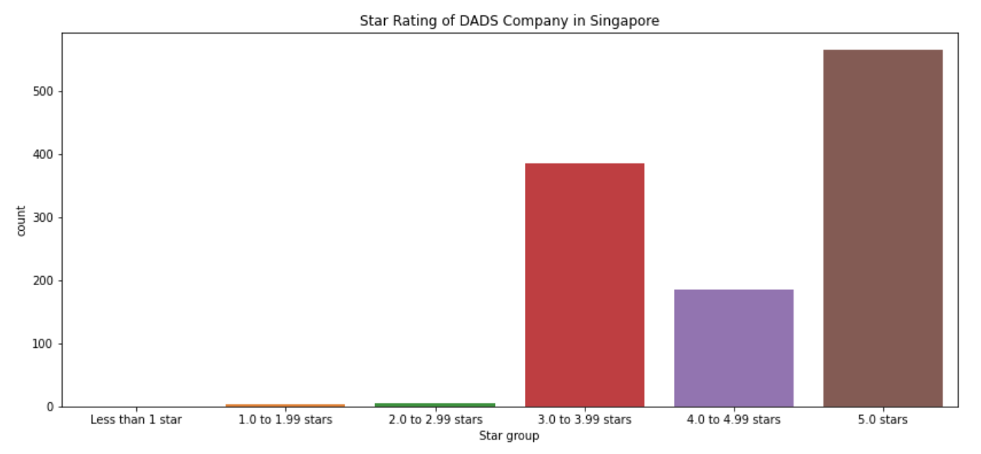
Ratings of DA / DS Jobs
HK
Average Score:
3.0 to 3.99 stars
Singapore
Average Score:
3.0 to 5.0 stars

Slide 19
Challenges
During Featuring engineering
Challenge 1 :
Code Processing
Challenge 2:
Imbalanced Data Size
Challenge 3:
Hard to set keywaord
Challenge 4:
Salary Category
Challenge 5:
Job Category

Slide 20
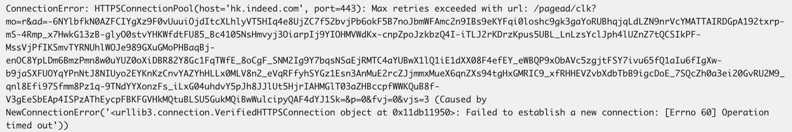
Challenge 1 : Code Processing
Time consuming during web-scraping
Re-run programme when there are some connection error

Slide 21
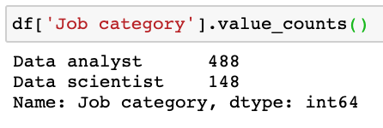
Challenge 2 : Imbalanced Data Size
Lead to inaccuracy in data analysis
Like salary analysis
Information are not provided in a standardised format
Omission of important data
Example
Salary
Language requirement
Education level
Skills set
Not all company will clearly mention information
Difficult to scrap
The smaller the data size, the fewer the information is scraped
Leads to Inaccurate Conclusion

Slide 22
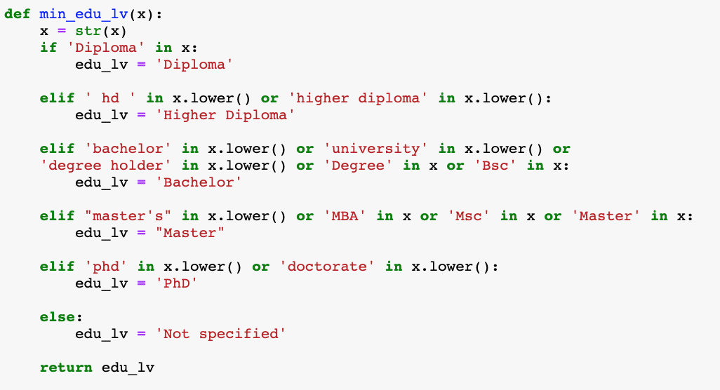
Challenge 3 : Hard to set keywords
Get qualitative data from Job Description
Many possible keywords
Not able to spot all
May omit some information from data
‘Master’
Could be just a verb in job description

Slide 23
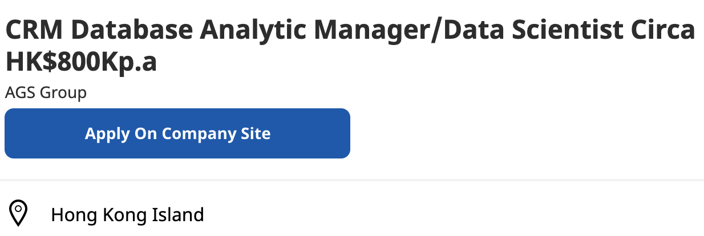
Challenge 4 : Salary Category
Mixing of Salary Category
Annual salary & monthly salary
Extraction of Salary From Job Title
Since values are not in same format
more effort in regex filtration
Can’t distinguish year salary from
Might include some annual salary
Affect accuracy of calculation

Slide 24
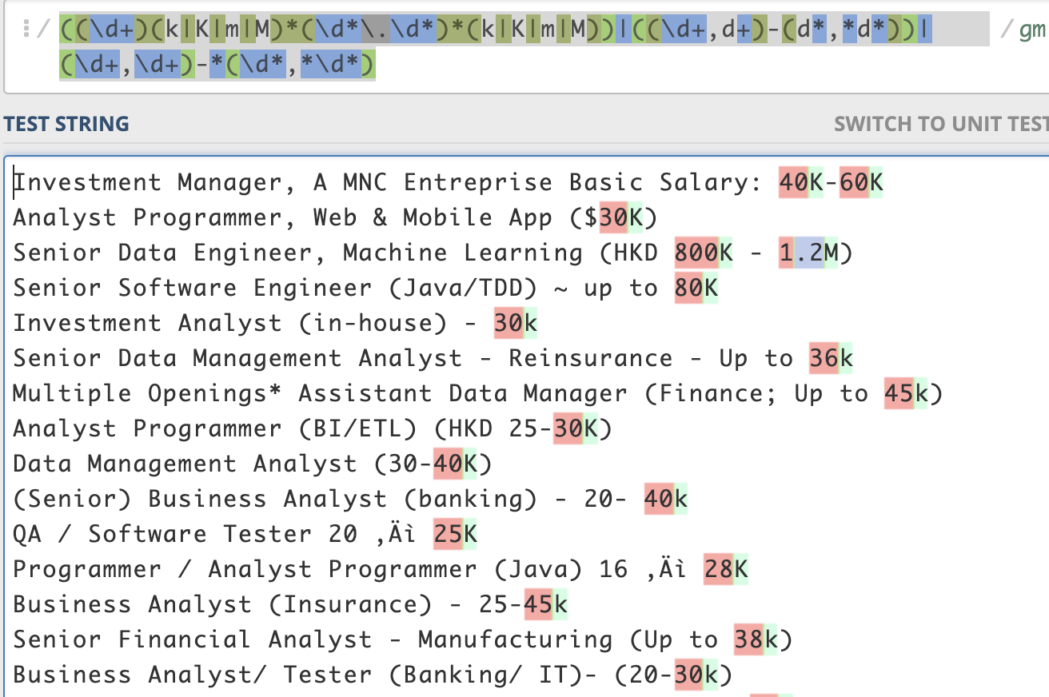
Challenge 4 : Salary Category
(Cont’d)
Find the Salary using regex
Only a few employers input the salary in header
Need to scrape data from Job title
Not all salary-related data can be spotted
Different format are created by manual Input
Some data may be omitted

Slide 25
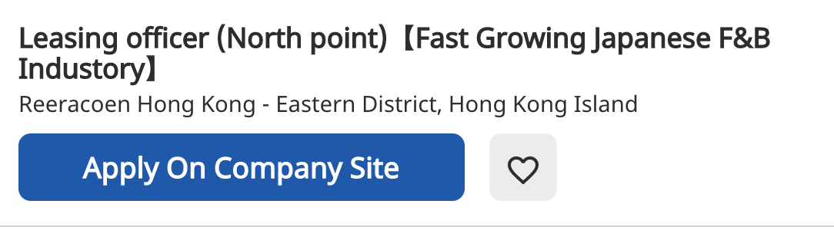

Challenge 5: Job Category Identification
Job title varies across companies
Low relevance towards searching keywords
Might include some irrelevant job
e.g. Programmer, IT support, Executive Secretary etc.

Slide 26
Observation & Conclusion
Number of job offer: #After filtration
SG(1145 total) >>> HK(636 total)
Huge variation in job requirements across companies
Data set accuracy :Singapore
Better structured data
Relatively accurate
Essential tool :
Python (Growing popularity)
Power BI & Tableau
Excel (Still important)
Education Requirement
Bachelor Degree
Average Salary
$20000-$40000

